Slide 1

Capstone 2 Presentation
Ashley Owings
April
2021

Slide 2
Problem Statement
The focus of this project is to identify the key factors that classify the genre of a song and create an algorithm that will define the genre based on those factors.
In this project, we will use a Spotify dataset already wrangled from Kaggle that will allow us to search the data for genre classifications. The data that we were able to capture includes a selection of music from the 1960’s to 2010’s.
Machine Learning Type:
Supervised Classification

Slide 3
Recommendations and Key Findings
The analysis found that the decision tree model was a strong representation of the pattern in the data.
The most important features to the analysis where time signature, energy, key, acousticness, and duration.
The key findings/ breakdown to define genre is:
Time signature – above/below 240
Energy – above/below .36
Key (only when time signature is less than 240 and energy is less than .36)
Acousticness – above/below .221
Duration (only when acousticness is over .221)

Slide 4
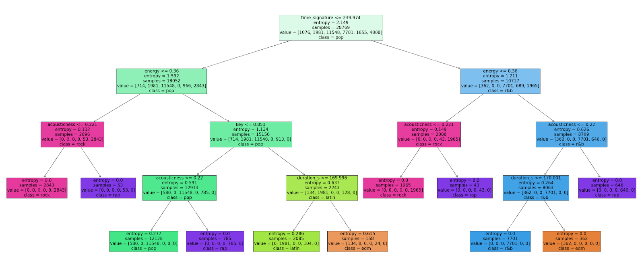
MODEL

Slide 5
Pop
Class Size: 16,460
Time Signature: less than 240
Energy: greater than .36
Key: less than .85
Acousticness: less than .22
Duration (in seconds): N/A

Slide 6
Rock
Class Size: 6,850
Time Signature: less than 240
Energy: N/A
Key: N/A
Acousticness: less than .22
Duration (in seconds): N/A

Slide 7
Rap
Class Size: 2,364
Time Signature: N/A
Energy: N/A
Key: N/A
Acousticness: greater than .22
Duration (in seconds):N/A

Slide 8
Latin
Class Size: 2,870
Time Signature: less than 240
Energy: greater than .36
Key: greater than .85
Acousticness: N/A
Duration (in seconds): less than 170

Slide 9
EDM
Class Size: 1,515
Time Signature: N/A
Energy: greater than .36
Key: greater than .85
Acousticness: N/A
Duration (in seconds): greater than 170

Slide 10
R&B
Class Size: 11,040
Time Signature: greater than 240
Energy: greater than .36
Key: N/A
Acousticness: less than .22
Duration (in seconds): less than 170

Slide 11

THANK YOU!

